Slide 1
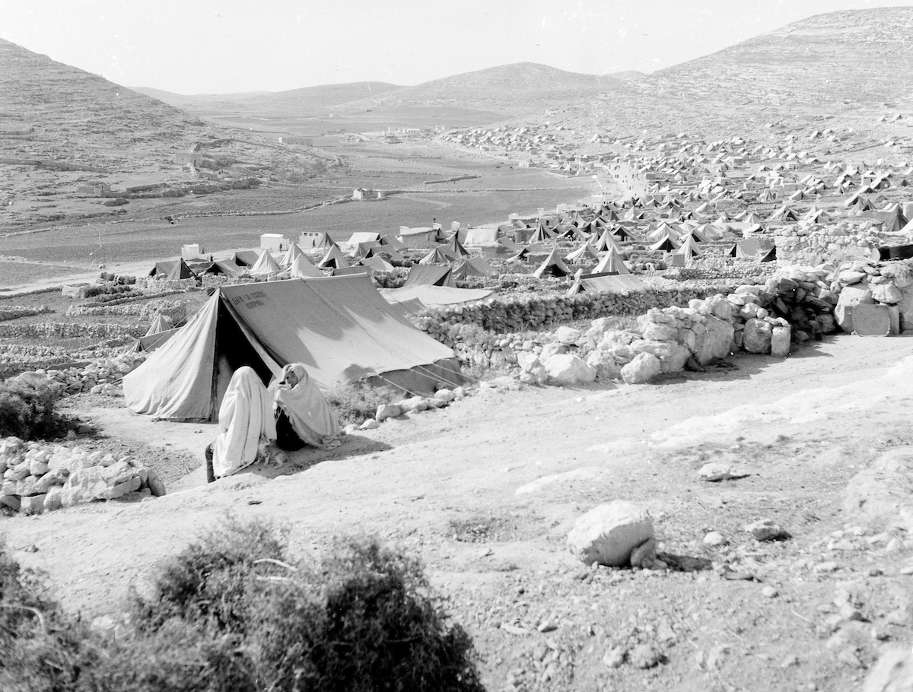
What happened in the 1950s?
Lesson 8

Slide 2
Learning objectives
By the end of this lesson, you should be able to:
  List the consequences of the Arab-Israeli War of 1948
  Describe what happened in 1956
  Explain how life differed for Palestinians and Israelis at this time

Slide 3
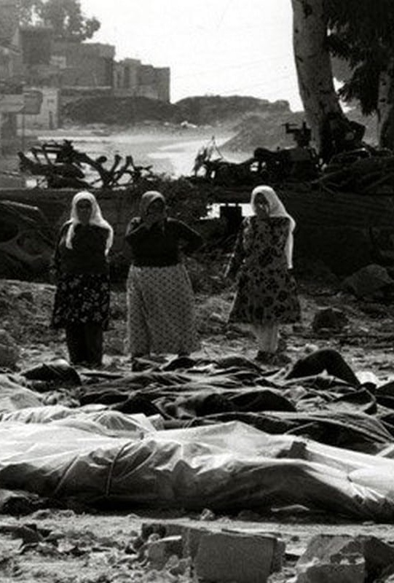
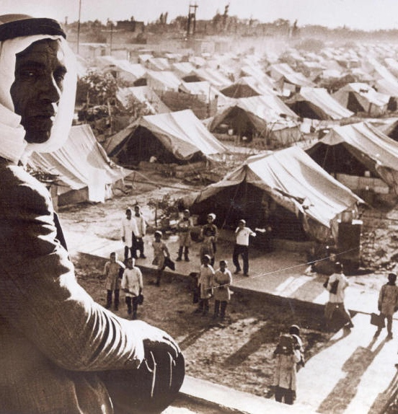
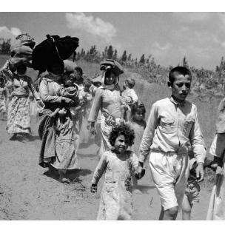
Recap: the Nakba
What was the Nakba?
What were the consequences of the Nakba for Palestinians?

Slide 4

8a. Keywords activity
In small groups, cut out these cards and match up the keywords with the definitions:
West Bank
____________________
a war between Israel and the surrounding Arab countries which resulted in Israel expanding its territory to include 78% of Mandate Palestine
David Ben-Gurion
____________________
the border between Israel, Egypt, Jordan, Lebanon and Syria after the Arab-Israeli War
Arab-Israeli War, 1948
___________________
a significant Egyptian leader. President of Egypt from 1954 to 1970
Gamal Abdel Nasser
___________________
the military of the state of Israel
Green Line
___________________
the area of Palestine-Israel which came under Jordanian control as a consequence of the Arab-Israeli War
Israel Defense Forces
__________________
a significant Israeli leader. The first Prime Minister of Israel

Slide 5


Next, cut along the green line and stick the matching keywords and definitions together into your glossary:
the military of the state of Israel
Israel Defense Forces
a significant Israeli leader. The first Prime Minister of Israel
David Ben-Gurion
the border between Israel, Egypt, Jordan, Lebanon and Syria after the Arab-Israeli War
Gamal Abdel Nasser
___________________
the military of the state of Israel
Green Line
the area of Palestine-Israel which came under Jordanian control as a consequence of the Arab-Israeli War
West Bank
a war between Israel and the surrounding Arab countries which resulted in Israel expanding its territory to include 78% of Mandate Palestine
Arab-Israeli War, 1948
a significant Egyptian leader. President of Egypt from 1954 to 1970
Gamal Abdel Nasser

Slide 6
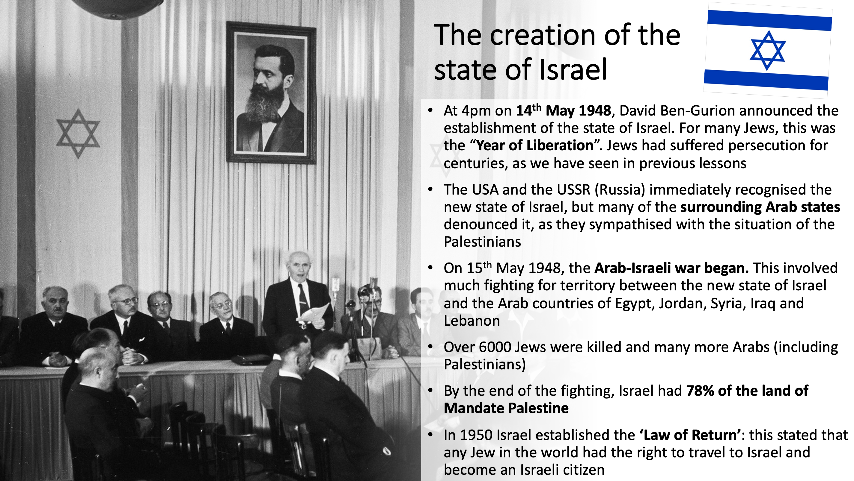
The Arab-Israeli War of 1948
As we saw last lesson, in the context of the Nakba, at 4pm on 14th May 1948, David Ben-Gurion announced the establishment of the state of Israel
The USA and the USSR immediately recognised the new state, but many of the surrounding Arab states denounced it
On 15th May 1948, the Arab-Israeli War began
This involved much fighting for territory between the new state of Israel and the Arab countries of Egypt, Jordan, Syria, Iraq and Lebanon
By the end of the fighting, Israel had 78% of the land of Mandate Palestine

Slide 7
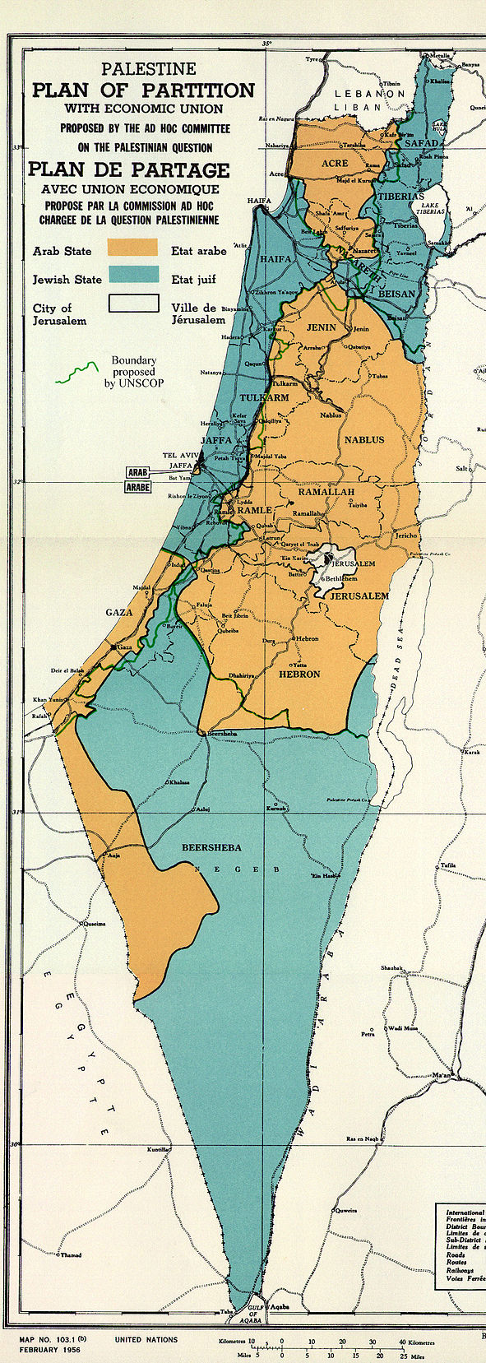
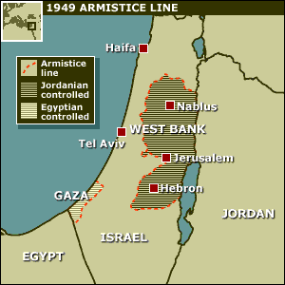

8b. The changing map of Palestine-Israel
Haifa
Tel Aviv
With a partner, write down three differences between these maps
___________________________
___________________________
___________________________
Extension question: using the map on the right, why do you think part of Palestine-Israel was now called the West Bank?
Gaza
Because this area was now part of the West Bank of Jordan
UN Partition Plan in November 1947
The new borders after the 1948 Arab-Israeli War

Slide 8

The consequences of 1948
Israel now controlled 78% of the land of Mandate Palestine (more than was proposed in the UN Partition Plan)
The Palestinian areas were controlled by neighboring Arab states: Gaza by Egypt and the West Bank by Jordan
The border around Israel became known as the “Green Line” (because green was the colour of the ink that the line was drawn in on the maps)
The city of Jerusalem was divided - Israel now controlled the western parts and Jordan controlled the eastern parts
Over 750,000 Palestinians were now refugees
Discuss with a different partner: what was the most important consequence of 1948? Why?
With another pair: are your answers the same or different? Why is this?

Slide 9
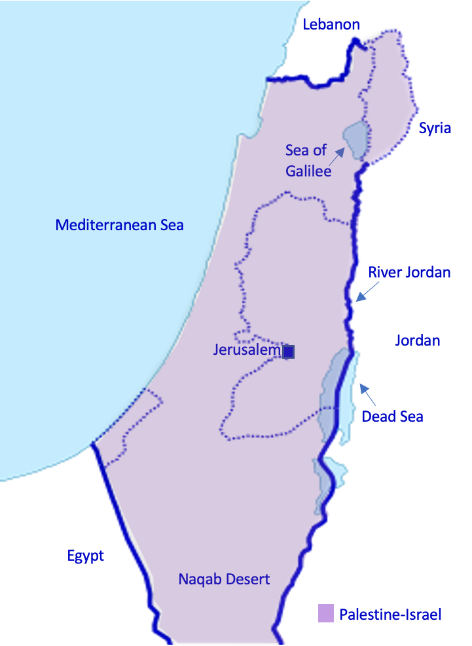
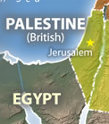
8c. Shifting borders
Before WWI, Palestine-Israel was part of the Ottoman Empire. But the Ottoman Empire fell apart in WWI, so the League of Nations gave Britain a ‘Mandate’ to govern Palestine responsibly
Palestine during the British Mandate
(1918-1948)
Britain governed Palestine between 1918 and 1948, but it had made contradictory promises to Palestinians and Jews about the future of the country. In 1947, it asked the United Nations for help
The UN suggested the country be partitioned into one Palestinian and one Jewish state. The British left the country, and war started between Israel and the surrounding Arab countries. Israel won a lot of land in this war
The new borders after the 1948 Arab-Israeli war
Palestine-Israel before WWI
(pre-1918)
UN Partition Plan in November 1947
Working individually, in the red box between each map, explain why the map of Palestine changed.
Extension question: How would these changes have made you feel if you were a) Palestinian b) Jewish?

Slide 10
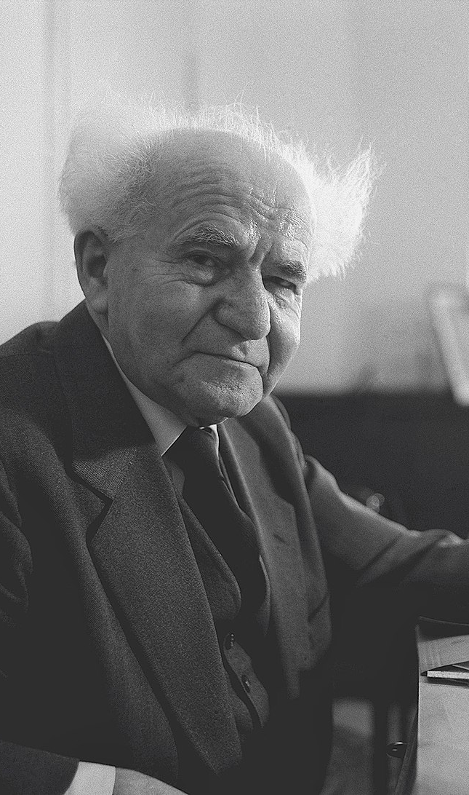

Life in
David Ben-Gurion’s new state of Israel
Who was David Ben-Gurion?
  The main leader of the Yishuv (the Jewish community in Mandate Palestine) after 1935
  The first Prime Minister of Israel, who led the country from 1948 until 1963 (with a short break 1954-55)
  Created the Israel Defense Forces: Israel’s military
What was the ‘Law of Return’?
In your book, create a short profile of David Ben-Gurion using the information in the textbook
This stated that any Jew in the world had the right to travel to Israel and become an Israeli citizen
By 1951 the population of Israel had doubled to over 1.3m

Slide 11
Meanwhile… for the Palestinians
Although 750,000 Palestinians had became refugees, many Palestinians remained within the new state of Israel’s borders
These Palestinians were placed under military law
Palestinians in refugee camps still hoped to return to their homes… but there was no sign of this happening
There was also further violence:
  Qibya massacre, 1953: 69 Palestinians were killed
  Al-Sammou, 1963: attack on Palestinians which led to the UN condemning Israel for "violating the United Nations Charter and the General Armistice Agreement"

Slide 12
Where did Palestinians live between 1948 and 1967?
Within the new state of Israel, as second-class citizens
In the West Bank, which was under Jordanian control
In Gaza, which was under Egyptian control
In 55 massive tented refugee camps in Jordan, Lebanon and Syria
These Palestinians have never returned home… in 2021, there were more than 7 million Palestinian refugees scattered across the world

Slide 13
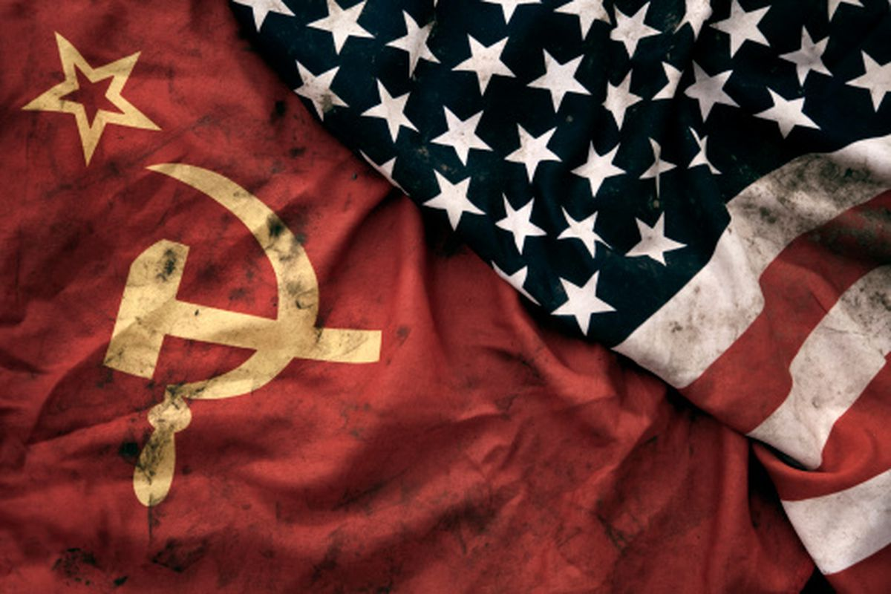
The global political landscape
As well as tension and violence between Israel and the new state’s Arab neighbours, 1948 until 1967 was characterised by the broader context of the Cold War
What was the Cold War?
The Cold War:
  A time of tension between the USSR and western countries (including the USA and Britain)
  Lasted from the 1940s until 1991
  It was about ways of ruling: communism vs. capitalism
  A ‘cold’ war because it never got ‘hot’ → there was no direct military action between the USSR and western countries

Slide 14

https://www.youtube.com/watch?v=0e7LZu_ceZQ&feature=emb_logo
Whilst watching this short video on the Suez Crisis, note down the answers to these questions in your books:
What is the Suez Canal?
Why did Gamal Abdel Nasser want to nationalise it?
Why did this become an international crisis?

Slide 15
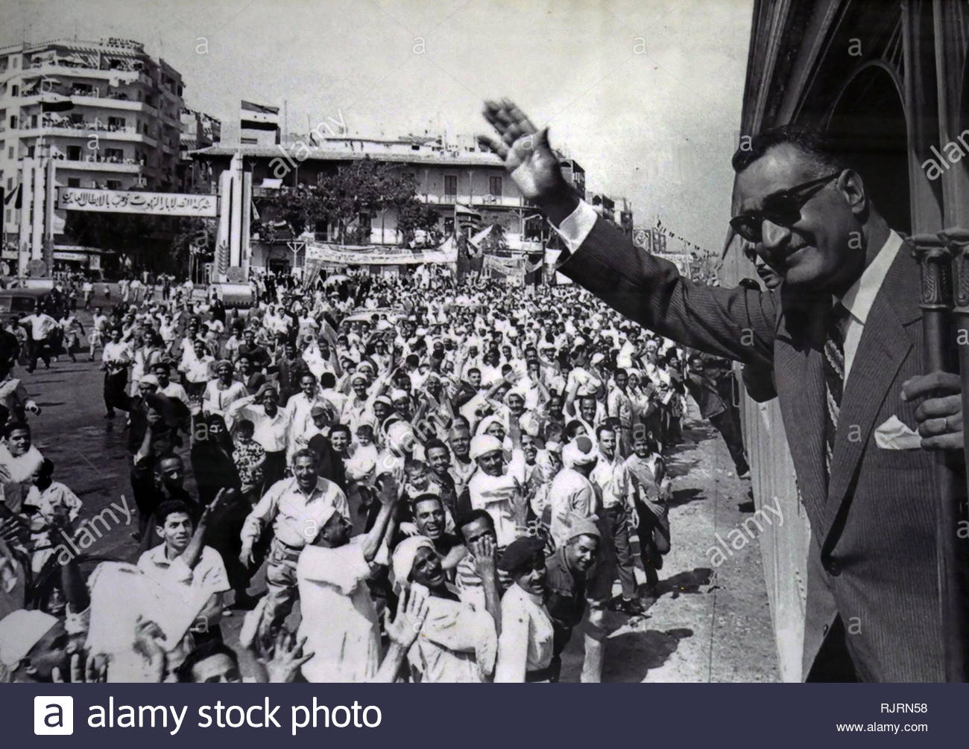
The Suez Crisis
What is nationalism?
the belief that one's country or state is distinct from and superior to others, and that it should govern itself
There was anti-colonial, nationalist feeling in Egypt
There was also support for Arab nationalism: a political movement to unite the Arab world. Nasser was seen as the leader of this
Nasser became even more popular after nationalising the Suez Canal Company in 1956 (effectively, he took it from British and French control into Egyptian control). Britain and France were not happy about this, and Israel was worried about Nasser’s popularity among Arabs
This led to a war between Egypt, Israel, Britain and France. Egyptians call this the Tripartite Aggression
After one week, the US and USSR forced Britain and France to stand down. Some say this signified the end of Britain’s role as a major power
For Israel it was good that Egypt’s military strength had been damaged so it was less of a threat
Based on this information, how would you describe the relationship between Israel and Egypt at this time?
In your book, create a short profile of Gamal Abdel Nasser using the information in the textbook

Slide 16
Plenary
  Using the 1949 map to help you, list three consequences of the Arab-Israeli War of 1948
  Where did Palestinians live in the 1950s?

Slide 17
Homework
To help you remember what happened to the Palestinians in 1947 and after, write a series of diary entries from the point of view of a Palestinian

